Slide 1
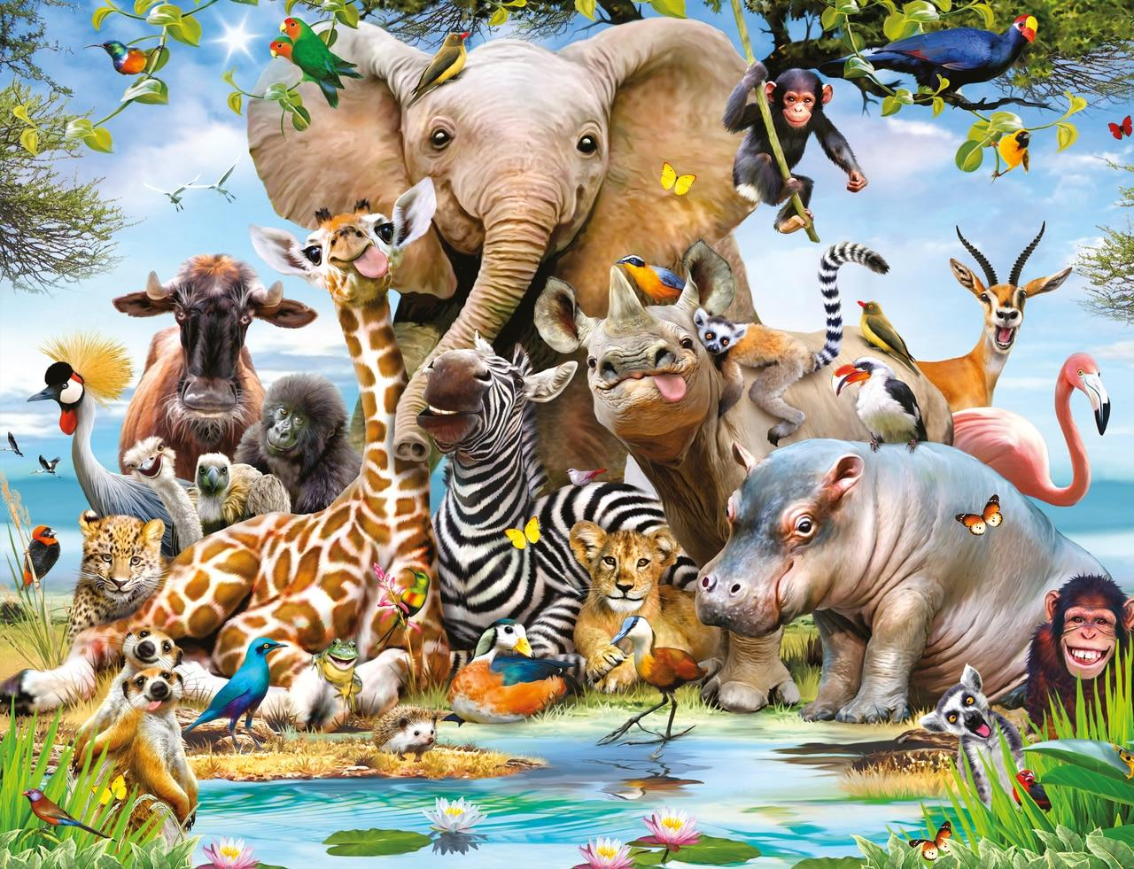

Year 2 Subject Safari: “Magnificent Monarchs”
Complete 2 tasks of your choice by half-term
Computing Research your favourite Monarch. Can you find any fun facts on them? | Art/DT/Cooking Draw or create a palace or castle fit for a monarch. Create a dish or meal fit for a monarch to eat. | Science Make a poster to show how we classify animals into the 6 different groups: Amphibians, Fish, Invertebrates, Mammals, Reptiles and Birds.
English Create a fact file on your favourite Monarch or write a diary entry as a King or a Queen for a day. | Maths Find at least 10 different number facts about Monarchs e.g. when a monarch was born/ died, how long they reigned for. How many children or wives they had etc. | Games/P.E Create a board game where the characters are monarchs or research the games that Queen Victoria or King Henry VIII use to play.
R.E/P.S.H.E Create a set of rules that you think you should follow if you met a King or Queen e.g. always courtesy or bow when you first meet them. | Music Learn or write a song about your favourite King or Queen. | History/Geography Create a time line of the life of your favourite King or Queen.

