Slide 1
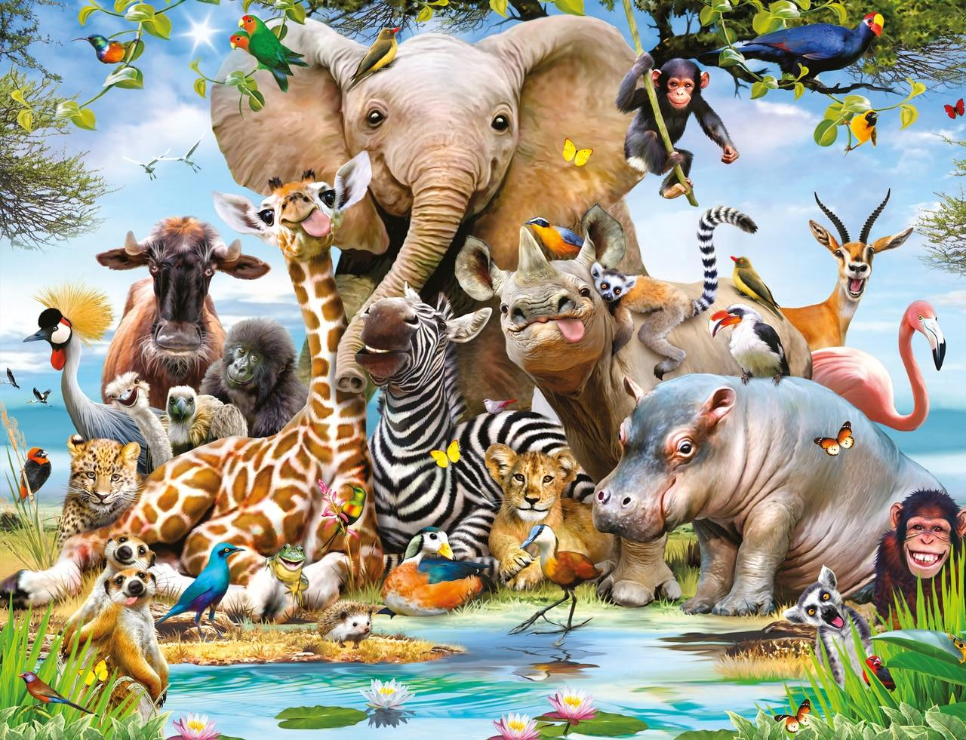


Year 1 Subject Safari
Complete 2 tasks of your choice by half-term
Computing Make an online safety poster. What can you do to stay safe online? | Art/DT/Cooking Can you draw a picture of flowers using continuous lines? | Science Plants some seeds in pots and observe them growing over the next few weeks. Draw and label the parts of the plant as you watch it grow.
English Write instructions on how to plant a seed using time connectives (first, next, then and last). | Maths Use chalk to write out your 2, 5 and 10 times tables. Can you count whilst jumping over the numbers? Can you start at any number and go backwards? | Games/P.E How many times can you bounce a ball against a wall and catch it? Can you beat your score?
R.E/P.S.H.E Write an acrostic poem for the word RESPECT. | Music Listen to different pieces music. Can you clap or march to the beat of the tune. Try to keep in time. | History/Geography Go for a historical walk around Otford. What buildings can you see? How long do you think they have been in Otford?

