Slide 1
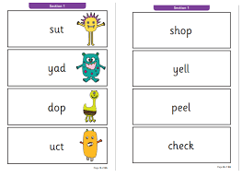

Welcome to Year 1’s Phonic workshop

Slide 2
What is phonics?
Phonics is a way of teaching children how to read and write.
Phonics involves matching the sounds of spoken English with individual letters or groups of letters.
For example, the sound k can be spelled as c, k, ck or ch. (view our sound chart)

Slide 3
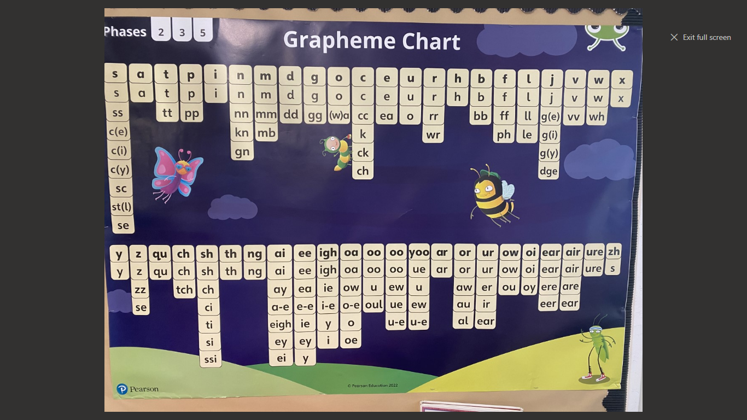

Slide 4
Vocabulary!
Phonics – the learning of letters and sounds
Phoneme – the sound a letter makes
Grapheme – the written letter
Blending – pushing sounds together to make a word (c…a…t…cat)
Segmenting – breaking a word up into its component sounds e.g. t-r-ai-n
Tricky words – words that cannot be decoded using phonics e.g. some, would etc
cvc – c = consonant (b/c/d/f), v = vowel (a/e/ee)
Digraph - a sound made with two letters eg. sh ai oi
Trigraph – a sound made with three letters e.g. igh ear air
Split digraph - a_e in snake o_e in phone

Slide 5
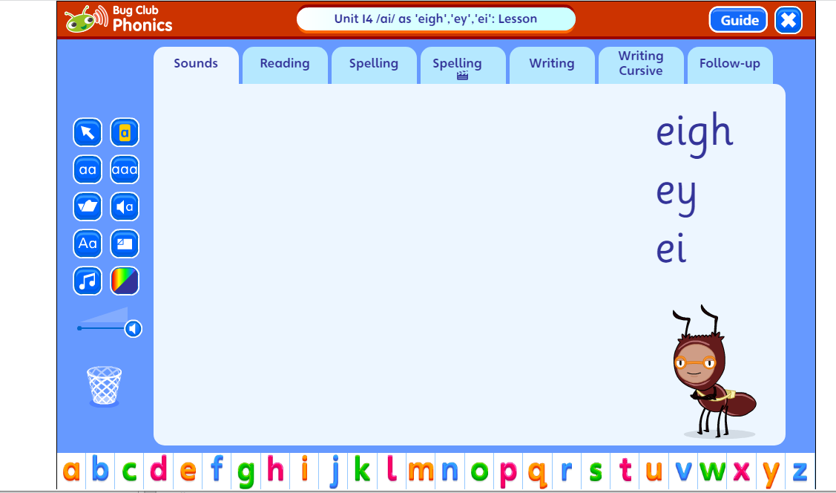
View bug club site – What does a lesson look like?
Phonic lessons always have a chance to learn new sounds, practise old ones, reading and writing new & learnt sounds.

Slide 6
What you can do at home?
Get your child to say the sounds and read the phonic and tricky words in the inside front cover of their Bug Club book. They can also think of other words with the sounds and spelling pattern in and put them into sentences.
Practise segmenting and reading alien words.

Slide 7
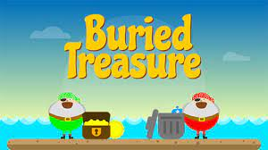
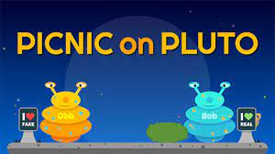
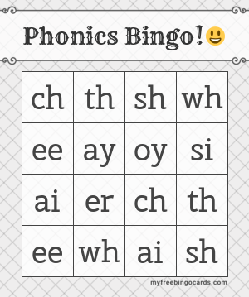
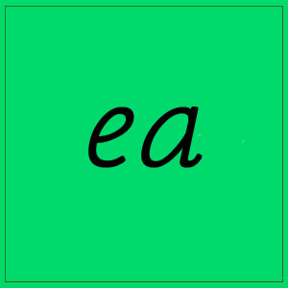
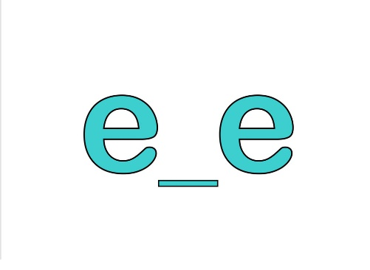
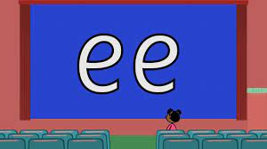
Games -
Phonic Play (some are free) these are great for alien and real words.
Sound bingo focussing on one sound? Their target sounds in their reading book.
Sound snap
Rhyming games e.g ay and oy – word endings.
We will send some games home
too.

Slide 8
Phonics screening
What is it?
A national screening test (June) where your child will be asked to read both real and alien words by segmenting and blending sounds in the words.
They need a score of (about) 32 out of 40 correct to pass and a score of 32 means that they are age appropriate at decoding at the end of year 1. It highlights any children that need additional phonic support to acquire phonics knowledge and skills.
When does it happen? 12th – 16th June throughout the week (mornings) & will be done by one of us.

Slide 9

Let’s have a look at a screening test being done:
https://www.youtube.com/watch?v=IPJ_ZEBh1Bk

Slide 10
Any questions?

