Slide 1
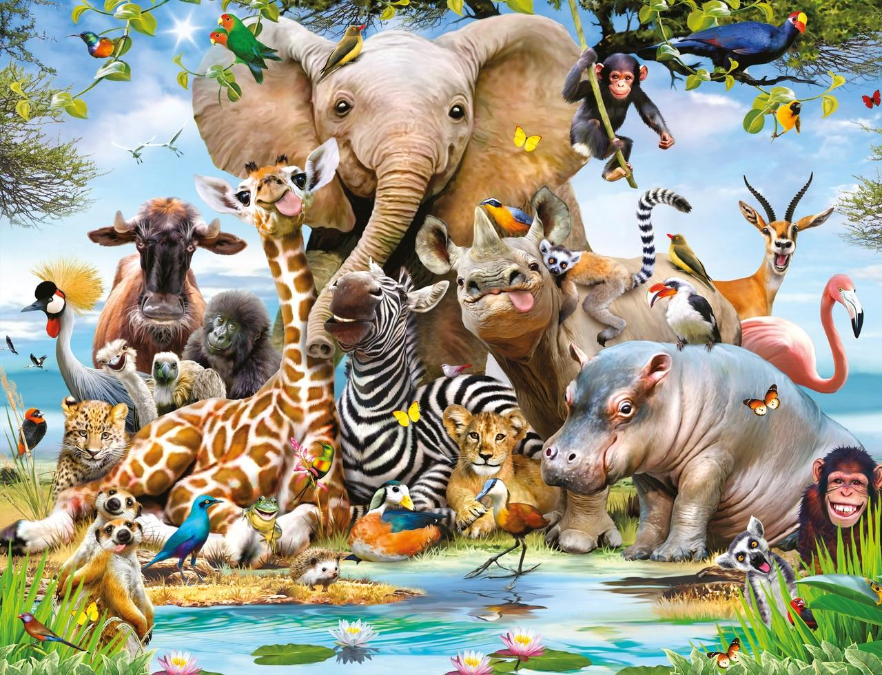

Year Subject Safari:“Topic title”
Complete 2 tasks of your choice by half-term
Computing Watch a time lapse video of a seed growing. Play the games and read the online books on Bug Club | Art/DT/Cooking Choose your favourite vegetables and get your family to help you cook something you like such as soup, a quiche or a salad Draw a still life picture of a vegetable or flower. | Science Plants some seeds in pots and observe them growing over the next few weeks. Take some pictures to monitor the growth. Help a family member plant new flowers and plants in the garden. Talk about the different parts of the flower.
English Create a seed diary. Draw a picture of your seed and label it. Draw weekly pictures of your seed growing and write how many leaves it has and how tall it is. | Maths Practice your number bonds to 10 every day. Learn your numbers 11 to 20 by counting out 10 objects then adding one more each time. . Play Numbots every day to try to unlock new levels. . | Games/P.E Practice how to use a skipping rope and count how many skips you can do. Can you skip more each week? Learn how to use a bat and ball by playing ball games with your family and friends.
R.E/P.S.H.E Read the Easter story with your family. Draw a picture of the part you liked best. Go on lots of walks with your family and look for all the new flowers and buds on the trees. See if you can name them. Try looking them up on the internet or in a book to learn more about them. | Music Listen to different pieces of classical music which were composed about flowers. Try to name the instruments you can hear in each piece of music. | History/Geography Look at some encyclopaedias to compare flowers that grow in this country and other places such as the desert, rivers, hot and cold countries

