Slide 1

Maths
At otford primary School

Slide 2
Growth mindset

Slide 3
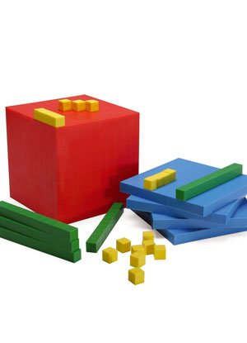
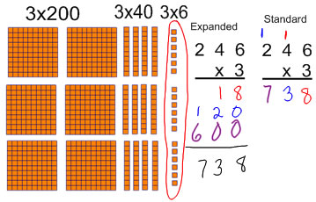
Concrete – Pictorial – Abstract
CONCRETE
ABSTRACT
PICTORIAL

Slide 4
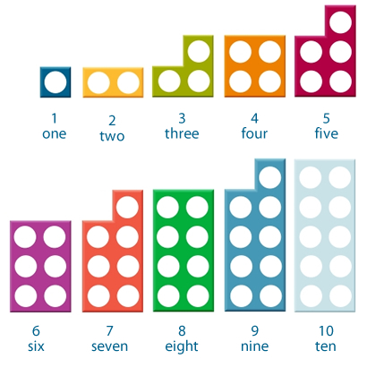
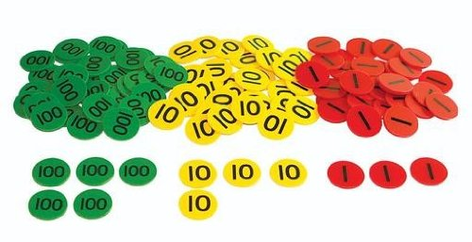
CONCRETE
DIENNES
BLOCKS
NUMICON
PLACE
VALUE
COUNTERS

Slide 5
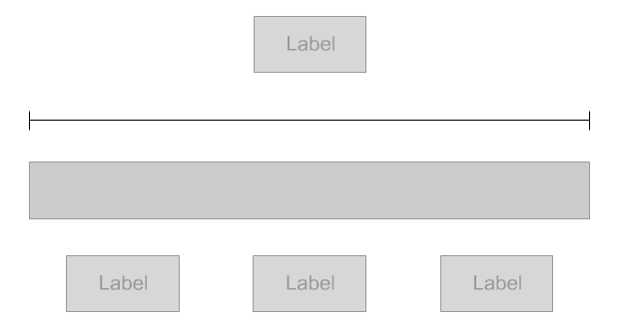
pictorial
Oliver had £19 in his wallet. He bought a DVD player for £8.
He also bought a book. Oliver had £6 left. How much did the book cost?

Slide 6
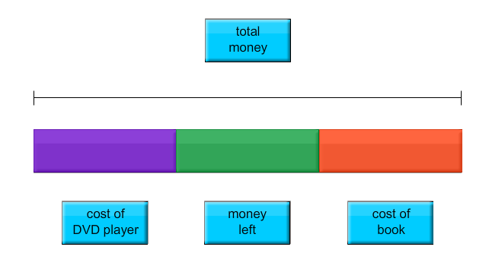
pictorial
Oliver had £19 in his wallet. He bought a DVD player for £8.
He also bought a book. Oliver had £6 left. How much did the book cost?

Slide 7
pictorial
Oliver had £19 in his wallet. He bought a DVD for £8.
He also bought a book. Oliver had £6 left. How much did the book cost?
£19
£8
£6
£?

Slide 8
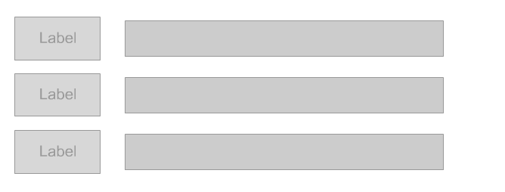
pictorial
Angela, Mason, and Jason were the top three winners in the spelling contest.
They shared a cash prize in the ratio 1:3:4. Jason received £18 more than Angela.
What was the amount of the cash prize?

Slide 9
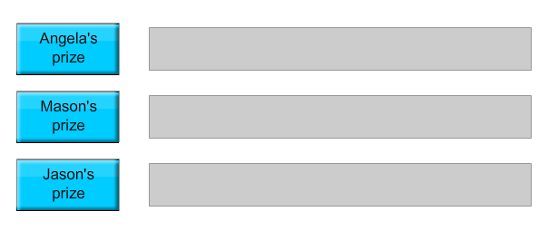
pictorial
Angela, Mason, and Jason were the top three winners in the spelling contest.
They shared a cash prize in the ratio 1:3:4. Jason received £18 more than Angela.
What was the amount of the cash prize?

Slide 10
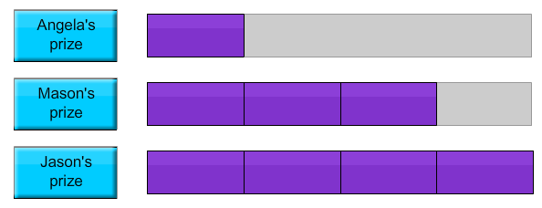
pictorial
Angela, Mason, and Jason were the top three winners in the spelling contest.
They shared a cash prize in the ratio 1:3:4. Jason received £18 more than Angela.
What was the amount of the cash prize?

Slide 11
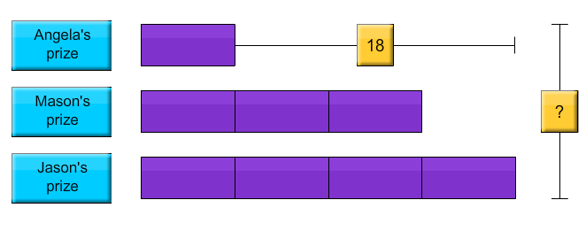
pictorial
Angela, Mason, and Jason were the top three winners in the spelling contest.
They shared a cash prize in the ratio 1:3:4. Jason received £18 more than Angela.
What was the amount of the cash prize?

Slide 12
pictorial
Angela, Mason, and Jason were the top three winners in the spelling contest.
They shared a cash prize in the ratio 1:3:4. Jason received £18 more than Angela.
What was the amount of the cash prize?
3 blocks = £18
1 block = £6
8 blocks = 8 x £6
= £48

Slide 13
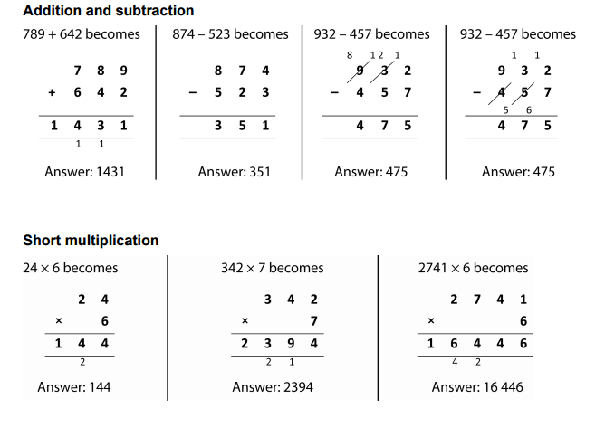
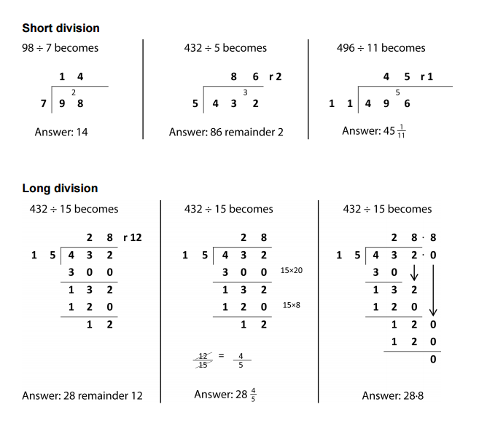
abstract

Slide 14
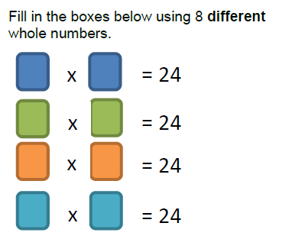
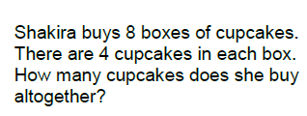
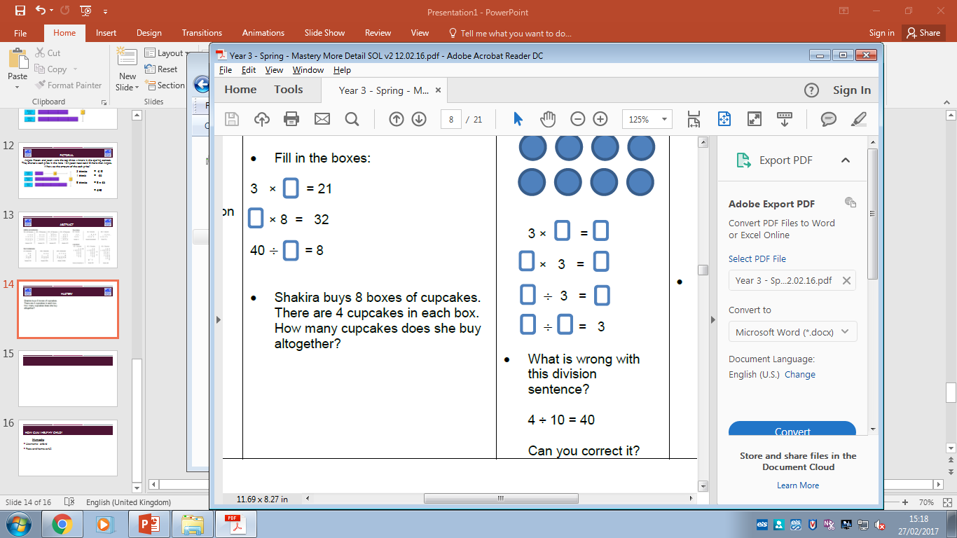
mastery

Slide 15
How can I help my child?
Mymaths
Username: otford
Password: homework2

