Slide 1
The English curriculum
Subject Leader – Rebecca Coles

Slide 2
What makes up the English Curriculum?
Reading
  Phonics – Word Reading
  Comprehension
  Guided Reading
  Reading for enjoyment
Writing
  Spelling
  Handwriting and Presentation
  Composition
  Vocabulary, Grammar and Punctuation
Speaking and listening

Slide 3
Reading
Word Reading

Slide 4
What is phonics?
It's all about sounds. There are 44 sounds in the English language, which we put together to form words.
Some are represented by one letter, like 't', and some by two or more, like 'ck' in duck and 'air' in chair.
Children are taught the sounds first, then how to match them to letters, and finally how to use the letter sounds for reading and spelling.
Synthetic phonics refers to 'synthesising', or blending, the sounds to read words. It's based on the idea that children should sound out unknown words and not rely on their context.

Slide 5
How do we teach phonics at Otford?
In school, we follow the Letters and Sounds programme. Letters and Sounds is a phonics resource published by the Department for Education and Skills which consists of six phases.
We use a number of resources that link to Letters and Sounds but primarily we use Floppy’s Phonics and Phonics Play.
Children are streamed into groups by ability to ensure they are taught at a level that is right for them.
The are assessed every term to ensure steady progress and intervention support is given where required.

Slide 6
What does a daily phonics session look like?
Revisit and Review
Teach
Practise
Apply

Slide 7

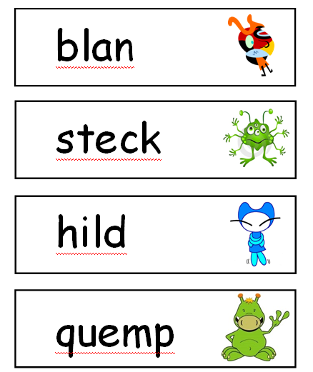
Phonics Screening
The Phonics Screening Check is meant to show how well your child can use the phonics skills they’ve learned up to the end of Year 1, and to identify students who need extra phonics help.
The checks consist of 40 words and non-words that your child will be asked to read one-on-one with a teacher. Non-words (or nonsense words, or pseudo words) are a collection of letters that will follow phonics rules your child has been taught, but don’t mean anything – your child will need to read these with the correct sounds to show that they understand the phonics rules behind them.
The 40 words and non-words are divided into two sections – one with simple word structures of three or four letters, and one with more complex word structures of five or six letters. The teacher administering the check with your child will give them a few practice words to read first – including some non-words – so they understand more about what they have to do. Each of the non-words is presented with a picture of a monster / alien, as if the word were their name (and so your child doesn't think the word is a mistake because it doesn't make sense!).

Slide 8
How can you help with phonics at home?

Slide 9
Reading
Comprehension

Slide 10
Key Skills in KS1
Draw on knowledge of vocabulary to understand texts.
Identify / explain key aspects of fiction and non-fiction texts, such as characters, events, titles and information.
Identify and explain the sequence of events in texts.
Make inferences from the text.
Predict what might happen on the basis of what has been read so far.

Slide 11
Key Skills in KS2
Give / explain the meaning of words in context.
Retrieve and record information / identify key details from fiction and non-fiction.
Summarise main ideas from more than one paragraph.
Make inferences from the text / explain and justify inferences with evidence from the text.
Predict what might happen from details stated and implied.
Identify / explain how information / narrative content is related and contributes to meaning as a whole.
Identify / explain how meaning is enhanced through choice of words and phrases.
Make comparisons within the text.

Slide 12
How reading is taught at Otford?

Slide 13


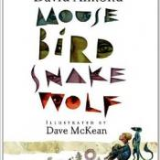



Power of Reading

Slide 14
Guided Reading
Instructional session, reading in a small group of children with similar reading ability.
Approaches to guided reading vary between schools.
At Otford;
  We try to teach children to select their own books.
  They learn which books are good good choice for them by selecting things that interest them and that they are able to read.
  Teachers need to have a certain amount of understanding about children’s authors so that they can make suitable recommendations.
  As children progress through the years their guided reading groups should resemble more or a book group.
  We encourage reciprocal reading groups – children are given a role with in their groups to notice certain things. These then act as discussion points.

Slide 15
Reading for Enjoyment
Children should be given the same autonomy to choose their books in the same way that adults do.
If they are made to finish something because they started it they they will have negative associations with reading.
Younger children will need guidance over what is suitable – they must understand what they are reading in order to enjoy it – decoding is not enough.
Take time to find the books that your children like. Don’t be afraid to return the ones they don’t!
At Otford we have a very well stocked library – all classes have a weekly slot where they can go and select books to enjoy.
The books that children read to practise phonics are not the same as the books they read for pleasure and it’s sometime helpful to make this clear to them.
Keep reading to your child! It doesn’t matter how old they are, they still love it! If you’re struggling to find the right books for them to read independently then read to them widely from a different selection of authors.
Please see the school website for Pie Corbett’s reading spines if you’re not sure where to start!

Slide 16
Writing
Spelling

Slide 17
No-Nonsense Spelling
There is little evidence that the traditional practice of learning spellings (usually 10) at home and being tested on them (usually on a Friday) is effective.
However, there is a high expectation within the new National Curriculum that pupils will learn many increasingly complex words.
At Otford we use No-Nonsense Spelling – It is a programme that follows a similar cycle to phonics teaching;
  Revise – Teach – Practise – Apply/Assess
The spelling pathways that each year group follows is available to view on the website.

Slide 18
What spelling strategies are taught?
Look, say, cover, write, check | This is probably the most common strategy used to learn spellings. Look: first look at the whole word carefully and if there is one part of theword that is difficult, look at that part in more detail. Say: say the word as you look at it, using different ways of pronouncing it if that will make it more memorable. Cover: cover the word. Write: write the word from memory, saying the word as you do so. Check: Have you got it right? If yes, try writing it again and again! If not, start again – look, say, cover, write, check.

Slide 19
What spelling strategies are taught?
Trace, copy and replicate (and then check) | This is a similar learning process to ‘look, say, cover, write, check’ but is about developing automaticity and muscle memory. Write the word out on a sheet of paper ensuring that it is spelt correctly and it is large enough to trace over. Trace over the word and say it at the same time. Move next to the word you have just written and write it out as you say it. Turn the page over and write the word as you say it, and then check that you have spelt it correctly. If this is easy, do the same process for two different words at the same time. Once you have written all your words this way and feel confident, miss out the tracing and copying or the tracing alone and just write the words.

Slide 20
What spelling strategies are taught?
Segmentation strategy | The splitting of a word into its constituent phonemes in the correct order to support spelling.
Quickwrite | Writing the words linked to the teaching focus with speed and fluency. The aim is to write as many words as possible within a time constraint. Pupils can write words provided by the teacher or generate their own examples. For example, in two minutes write as many words as possible with the /iː/ phoneme. This can be turned into a variety of competitive games including working in teams and developing relay race approaches.

Slide 21
What spelling strategies are taught?
Drawing around the word to show the shape | Draw around the words making a clear distinction in size where there are ascenders and descenders. Look carefully at the shape of the word and the letters in each box. Now try to write the word making sure that you get the same shape.
Words without vowels | This strategy is useful where the vowel choices are the challenge in the words. Write the words without the vowels and pupils have to choose the correct grapheme to put in the space. For example, for the word fi eld:

Slide 22
What spelling strategies are taught?
Drawing an image around the word | This strategy is all about making a word memorable. It links to meaning in order to try to make the spelling noticeable. You can’t use this method as your main method of learning spellings, but it might work on those that are just a little more difficult to remember.

Slide 23
What spelling strategies are taught?
Pyramid words | This method of learning words forces you to think of each letter separately. You can then reverse the process so that you end up with a diamond.

Slide 24
Writing
Handwriting and Presentation

Slide 25
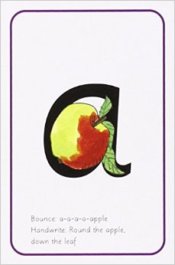
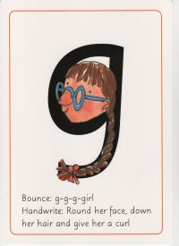
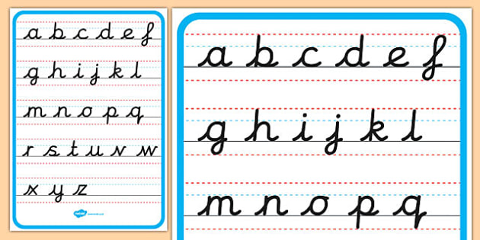
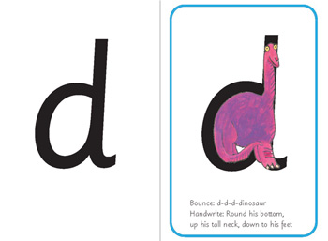
Print Cursive

Slide 26
Writing
Composition

Slide 27

Children as Writers
First comes the reading and speaking – then comes the writing!
Children must be taught to reinvent stories they know – as all writers do.
They must be taught to speak in the style of writing they want to use.
In KS1 chn will orally rehearse what they want to say orally before writing.
In lower KS 2 children will keep rehearsing what they want to say orally but will look more closely at texts to adopt the same tone and style.
In upper KS2 children will continue to model their writing on texts they have experienced in class but will learn to select the audience and purpose.
Please look at the progression documents on the website if you are interested to see this progression in more detail.

Slide 28
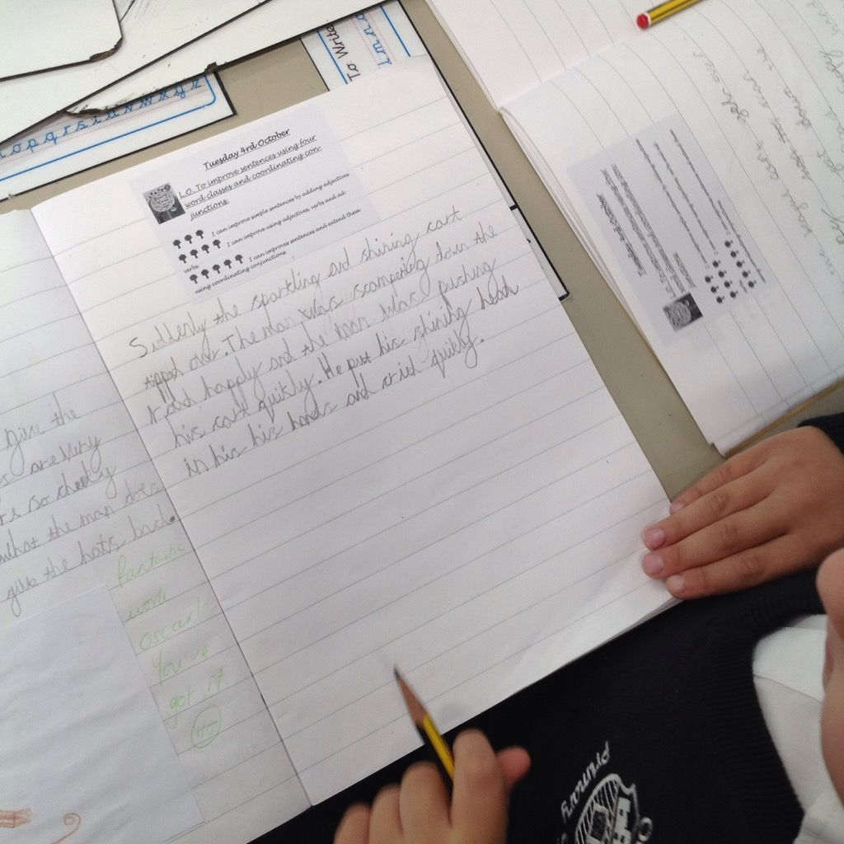
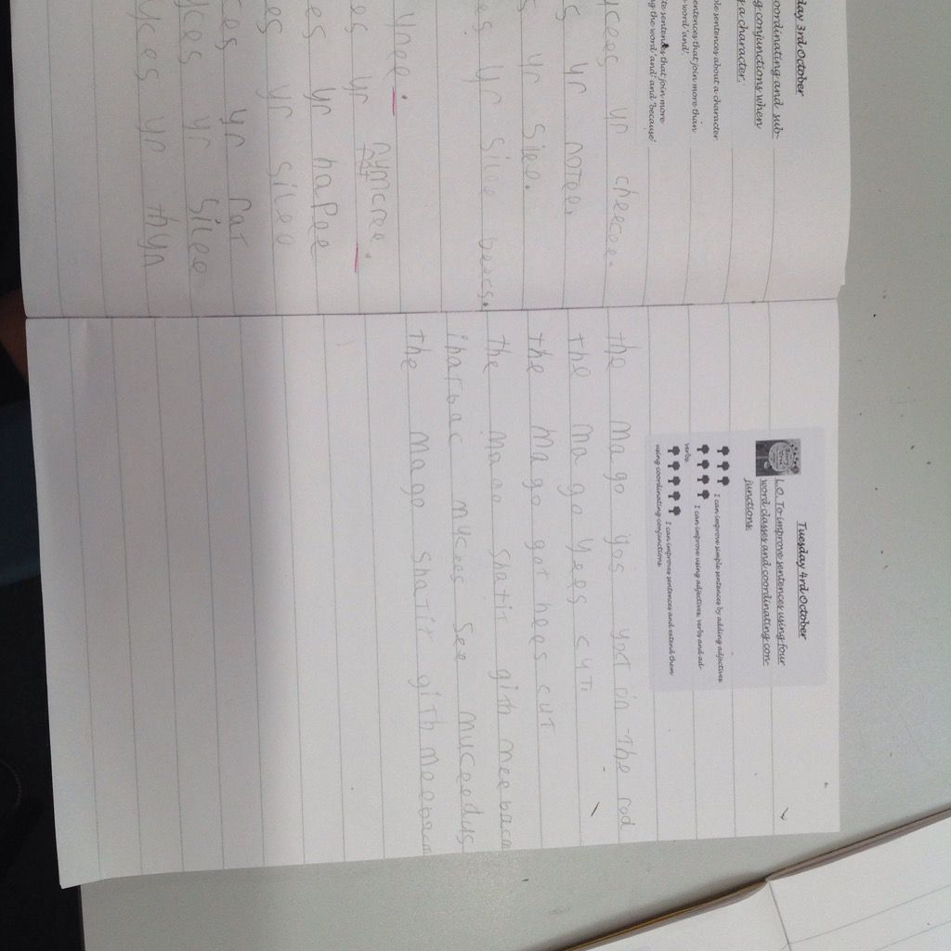
Writing at Otford
Writing is a journey - Based around Power of Reading text
  Teachers select the genre of writing that fit well with the text
  Teachers then identify the grammar, punctuation and spelling patterns that children will need in order to successfully write in the same style and tone.
  Children will be immersed in the style of writing – looking at texts that are similar, studying characters, role-playing and imagining the setting.
  The journey should give them all the tools they need to write successfully – then the teacher is in a position to assess what the children have learned and what still needs to be covered.

Slide 29
Writing
Vocabulary, Grammar and Punctuation

Slide 30


What does it all mean?
Grammar!
See the school website for a glossary of all the terms and their meaning!

Slide 31
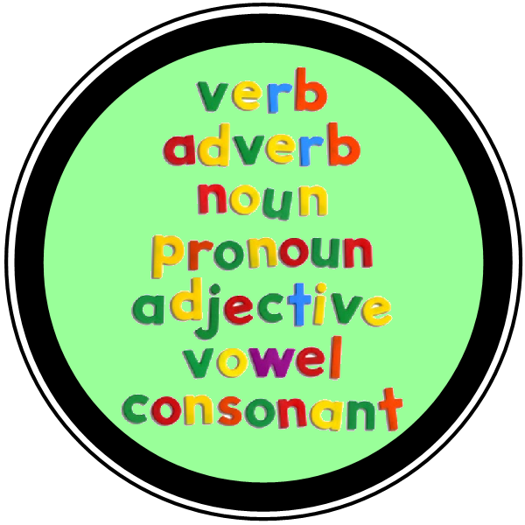
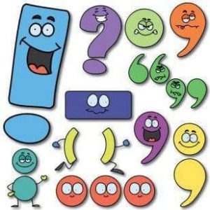
Vocabulary, Grammar and Punctuation at Otford
Daily Basics – children have daily, fast paced sessions to keep going over and covering the grammar and punctuation they have been taught in different year groups.
Through power of reading – more complex patterns of grammar taught through literacy lessons in the context of Power of Reading.
Children will also be encouraged to make links to the grammar they have been taught and the Power of Reading text but they will also be encouraged to notice how other writer use them.
You can help at home by still reading aloud to your child – in doing this you free them up to be thinking about how the author has engaged their reader and enhanced meaning with their vocabulary and grammar choices.

Slide 32
Speaking and listening

Slide 33
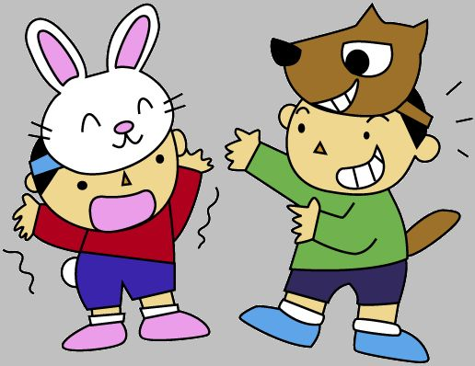
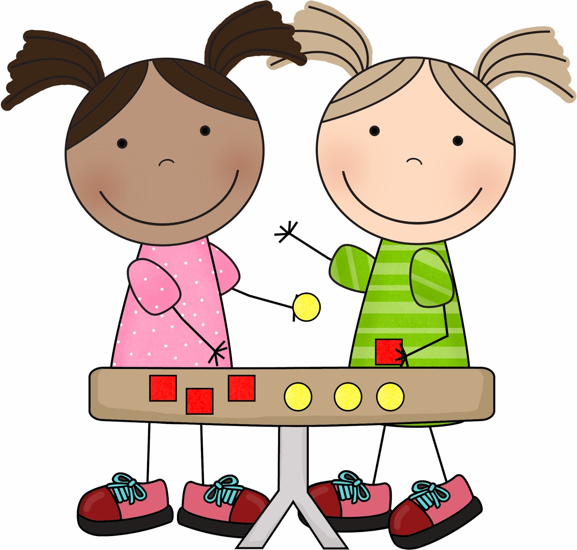

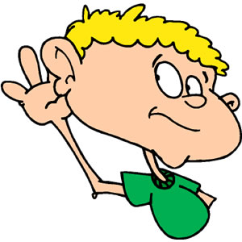


How is it taught?
Drama and Role-Play
Talk partners
Debate
Listen and respond
Discussion
Explain

