Slide 1


Partnership Power
Maths and English - Learning at Home

Slide 2
Education Endowment Foundation – The Research:
Key findings
Parental engagement has a positive impact on average of 4 months’ additional progress.
Support is most effective when home learning is of high quality. For example, providing practical strategies with tips, support, and resources to assist learning at home may be more beneficial to pupil outcomes than simply gifting a book to pupils or asking parents to provide generic help to their children.

Slide 3
Common misconceptions:
When we are speaking about writing, we aren't just meaning handwriting! Writing includes grammar, punctuation, spelling, vocabulary, composition, sentence construction, context, purpose, audience.....
National curriculum in England: English programmes of study - GOV.UK (www.gov.uk)
Reading is not just about fluency and whether children can read the words and use expression and intonation. Reading is about vocabulary, inference, prediction, explanations, retrieval and summarising! VIPERS
Maths is more than 'getting it right'. It is about fluency, arithmetic and reasoning. Children need to know how to use methods efficiently and how to choose the correct one. In school we learn using CONCRETE-PICTORIAL-ABSTRACT.

Slide 4
Where do I start? Online or Games or Pencil and Paper – Whatever suits your child and your lives!
My Maths - this is used for homework but your child can practice any of the lessons or activities Parent and carer support | MyMaths help and support
White Rose – this is used in school. Supporting videos are available for free (just ensure you select the correct year group!) Maths home learning | Home learning | White Rose Maths
Lots of free resources and parent support booklets that are accessible for free: Advice and guidance for parents | White Rose Maths
There are also free children's workbooks available to download: Parent resources | Maths workbooks | White Rose Maths
Download the 1 minute white rose app – it is great and free!Introducing our brand-new app, 1-Minute Maths! | News | White Rose Maths
Super movers – We use these short videos in school for rehearsal and brain breaks Times tables collection - BBC Teach
Spelling Shed – various online games. Practise and learn the Common Exception Words (tricky words)! Sight read and be able to SPELL these – it is tricky!!

Slide 5
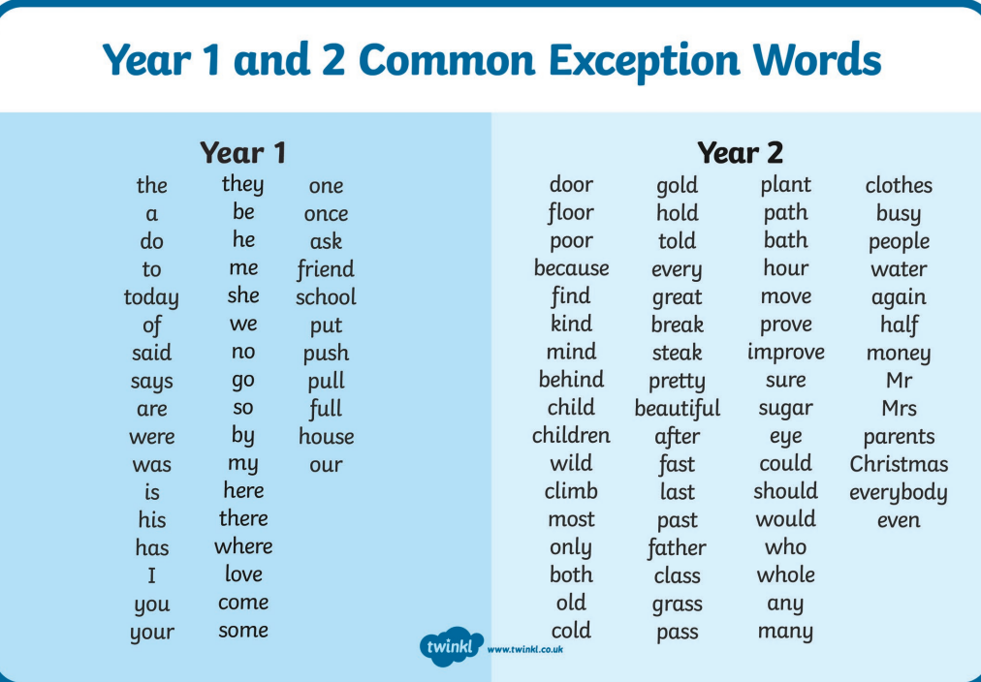

Slide 6
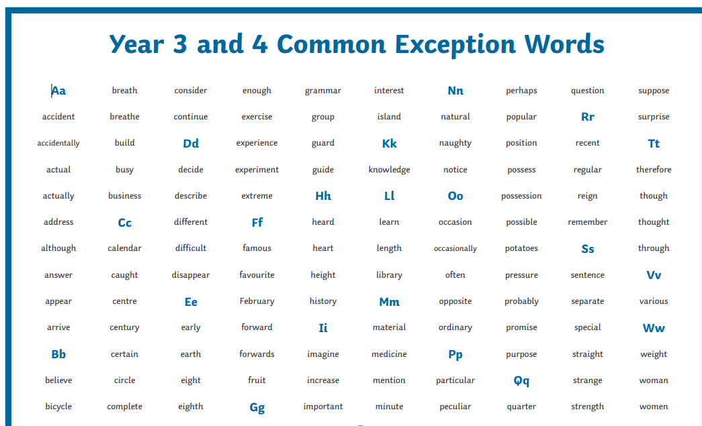

Slide 7
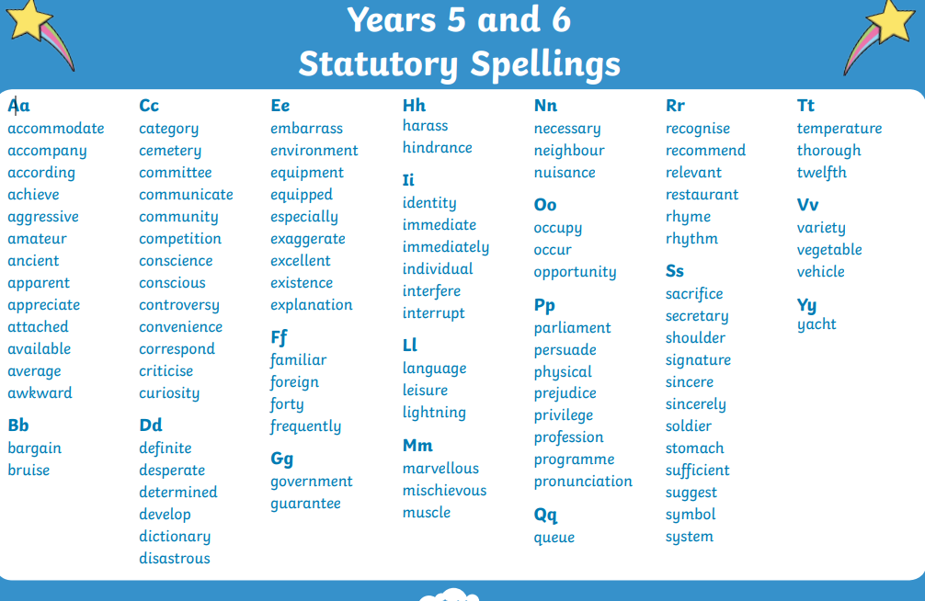

Slide 8
Playing games – This is a great way of building confidence and having fun – keep it simple and open ended. Focus on justifying and reasoning – this is about depth of understanding!
Odd One Out – pick 3 things and reason about which one is the odd one out. You can make it as simple or varied as you like!
E.g. 'whisper, tiptoe, shout' Shout could be the odd one out because it is loud. Tiptoe could be the odd one out because it is not using your voice.
'jump, run, clean' Clean could be the odd one out as the others are verbs to do with travel. Run could be the odd one out because it has an irregular past tense (ran as opposed to jumped/cleaned).
'2,4,9' 9 could be the odd one out because it is odd. 9 could be the odd one out because it is the only squared number.
And Another – take it in turns to challenge each other to say another one. Again this can be at any level!
E.g Verbs which are to do with eating: 'chewing and another' 'munching and another' ….
Multiples of 3 – simple – '12 and another' '15 and another'…... or more complex ' 6 and another' '66 and another' '666 and another'

Slide 9
Same and Different
This is a simple comparison game using knowledge and vocabulary
E.g. Rectangle and Circle – Same – both are 2D shape Difference – they have different numbers of sides
Red and Blue – Same – both are colours/can be nouns or adjectives- Difference – they are associated with different feelings
Always/Sometimes/Never
Pose a question – is it always true, never true or sometimes true? Explain!
E.g. Multiples of 5 end in 5 – Sometimes true as they can also end in 0
Prove it!
Find evidence in your reading book to justify your inferences. E.g. I think it is summer because it says that the sun is shining and the character is sweating.
Give the answer to a calculation and ask the child to prove it (through objects or drawings or another number sentence)
Alphabet games
Adjectives starting with A – awesome, B- brilliant etc.
Maths vocabulary starting with A – addition, B- bigger, C- circle etc.

Slide 10
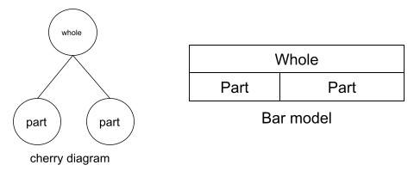
For Maths, part whole models are used a lot!
https://thirdspacelearning.com/blog/what-is-part-whole-model/

Slide 11
For Reading, please use the VIPERS question stems when reading at home:
English | Otford Primary School
Little and often is great! Daily reading for fluency and decoding, and some VIPER questions.
For reluctant readers:
Reading together – a sentence, paragraph or page each – read to them and ask the VIPERS questions and encourage them to read a small part
Make it fun – silly voices for characters
Make it easy to build their confidence
Choose books with interesting fonts – child reads those parts e.g David Walliams, Tom Gates
Child reads the 'speaking' parts or certain common exception words – any participation is great!
Trips to the library – choices over books/reading

Slide 12

Please remember that Home Learning should not be a battle and cause upset at home. We can adapt homework too so please do reach out to your teachers!
If your child does not have a quiet space at home, or it is challenging for another reason, please do speak to us as we can support them within school.

