Slide 1
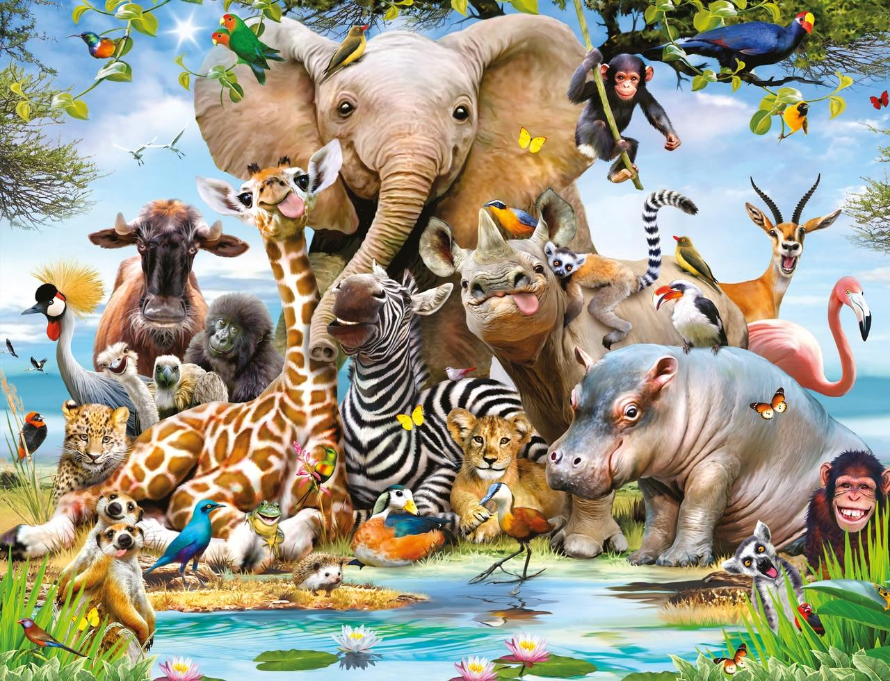

Year 5 Subject Safari:“Space”
Complete 2 tasks of your choice by half-term
Computing Use 2Quiz on Purple Mash to make up a quiz with facts about Space. Make sure you also have the answers! | Art/DT/Cooking Plan a space friendly meal! (Something that won’t cause a mess if it floats off!) What would your main meal be? What would you have for pudding? What would you choose to drink? Have you planned a balanced diet? | Science Research gravity – what it is and who discovered it. Share your findings in a creative way, for example a poster.
English Write a postcard from an astronaut in space. Tim Peake perhaps? | Maths Find out the temperature for all of the planets and use a graph to display your results | Games/P.E Explore the Otford Solar System, in the park opposite the school, and take photos of your adventure!
R.E/P.S.H.E Important recent religious festivals are Passover, Ramadan and Easter. Research one and make an information leaflet. | Music Write your own rap based on the planets. Either record a performance of your rap or write it down. | History/Geography Research the Apollo 11 mission to the moon. Write a newspaper article about this event.

