Slide 1
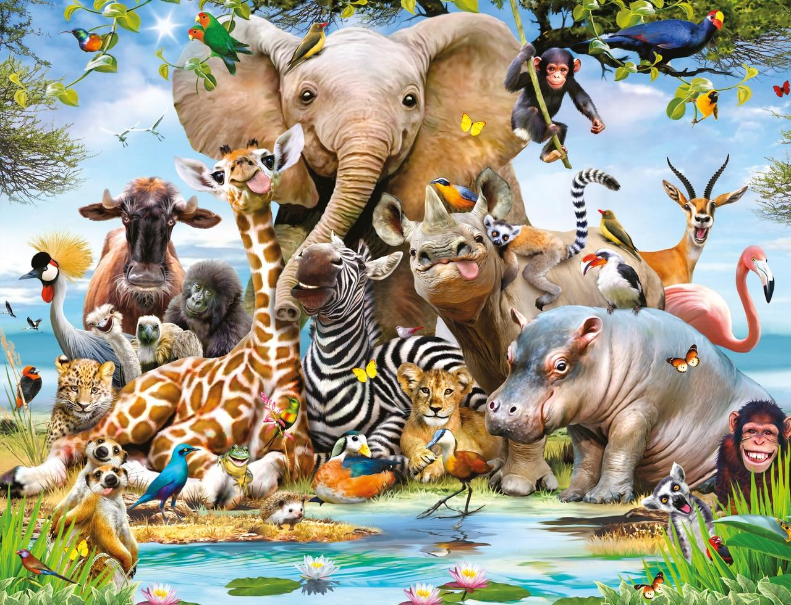

Year 4 Subject Safari: “Ancient Civilisations”
Complete 2 tasks of your choice by half-term
Computing Create a fact file or PowerPoint about the Pyramids of Egypt. | Art/DT/Cooking Design a matchbox tomb. After mumification, people were buried in a tomb wearing a death mask. Design a death mask for Tutankhamun. | Science Mummify a tomato using salt, bicarbonate of soda or Epsom salts. Make predictions and record your findings.
English Imagine you were there when Howard Carter discovered Tutankhamun’s tomb. Can you write a newspaper report about the event? | Maths The Ancient Egyptians had their own number system, very different to the numbers we use today! Can you use it to create number sentences for the class to answer? Can you write some Egyptian themed word problems? | Games/P.E Create a dance or gymnastics routine to traditional Egyptian music. Think about ways of travelling and balancing.
R.E/P.S.H.E The Ancient Egyptians believed in many Gods. Can you choose one to research? | Music What sort of instruments were used in Ancient Civilisations? Can you draw and label one? | History/Geography On a map of Egypt, mark out important, famous landmarks and features e.g the River Nile, Pyramids. Find out about different jobs in Ancient Egypt and compare them to jobs we have today

