Slide 1
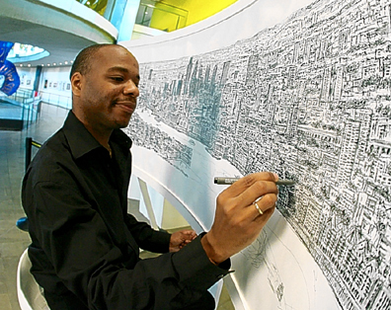
Celebrating artists with disABILITIES and/or Learning Differences
International Day of People with Disabilities, December 3rd 2020

Slide 2
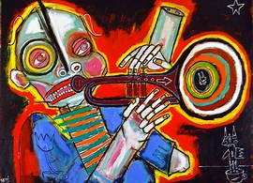
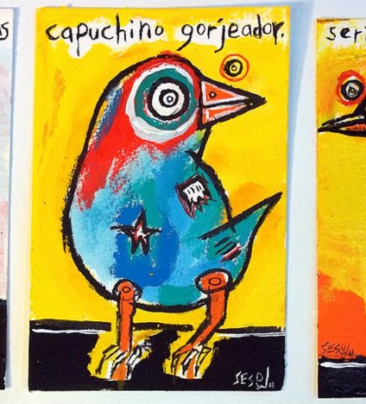
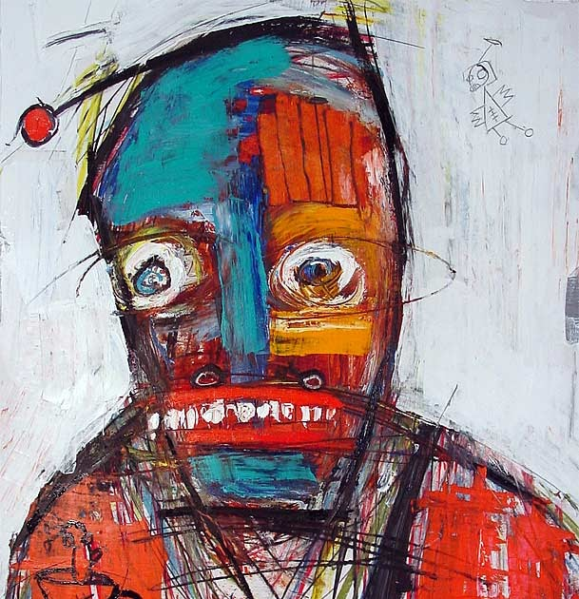
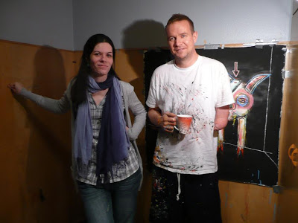
Matt Sesow (born 1966)
Matt Sesow is a full-time painter… living and painting in Washington, DC. On a summer evening when he was eight at an airfield near his home, he was struck by the propeller of a landing airplane. The accident resulted in his left arm being severed and the loss of his dominant left hand.
ARTIST STATEMENT (2014):
Painting is something I do everyday and it is what I intend to do for the rest of my life. Painting has healed me. I found painting was a cure to the emotional pain I felt from losing my left hand as a chid.
Task:
Create a portrait of yourself or that of a member of your family by your non dominant hand.

Slide 3
Artists with Austism
What is Autism?
Autism occurs when a person has trouble communicating and understanding what people think and feel. This makes it very difficult for autistic children to respond to gestures, facial expressions, touch and even language.

Slide 4
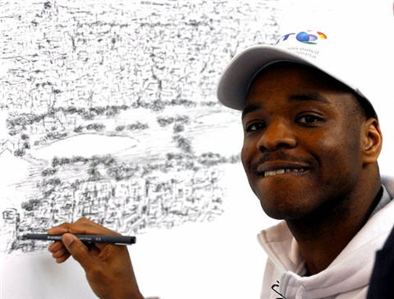
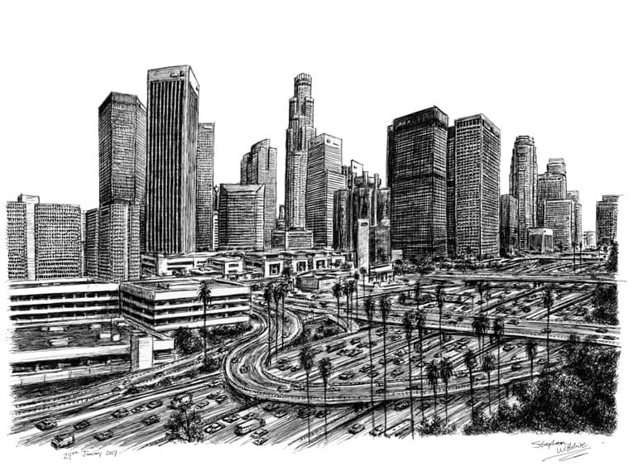
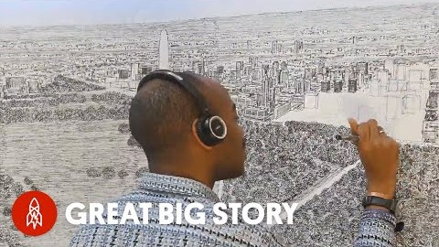
Artists with Autism
Stephen Wiltshire is an artist who draws detailed cityscapes. He has a particular talent for drawing lifelike, accurate impressions of cities, skylines and street scenes after having only observed them briefly. He was awarded Member of the Order of the British Empire for services to the art world in 2006. His drawings are popular all over the world and are held in several important art collections and museums.
Stephen started drawing at the age of five and sold his first work to the Prime Minister of the United Kingdom at the age of eight. Sir Hugh Casson, President of London's Royal Academy of Art, referred to him as the best child artist in Britain. Stephen has since travelled the world and exhibited on every continent with record attendances. He continues to draw every day and his motto is 'Do the best you can and never stop'.

Slide 5
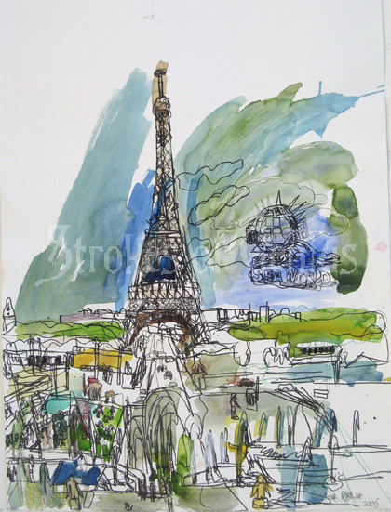
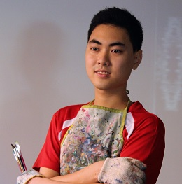
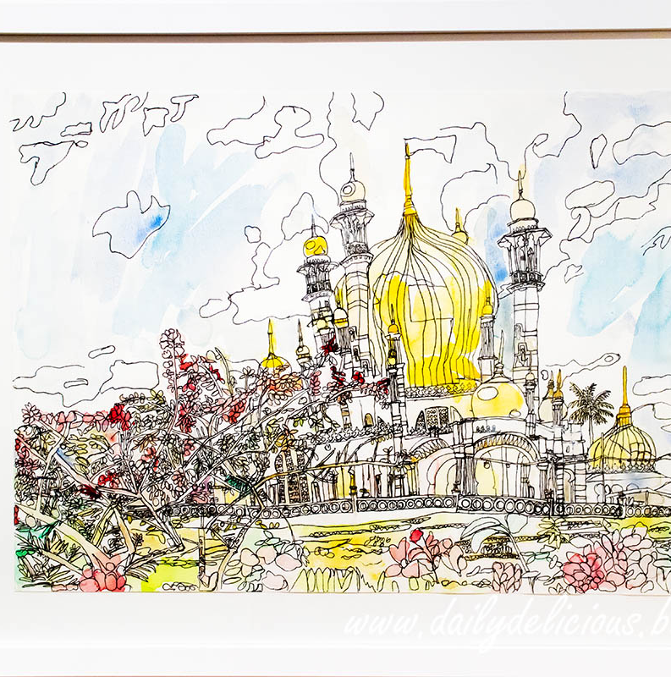
Artists with Autism
Ping Lian Yeak is an artist with autism. He was born in Malaysia, 1993. He lives in Sydney, Australia since May 2006. Initially Ping Lian was hyperactive, living in his own world, not showing affection or awareness of danger, unable to hold a pencil to write or use scissors to cut.
In order to strengthen and develop Ping Lian’s fine motor skills, his home program focused on tracing and colouring activities.
At the age of 8, Ping Lian out-grew tracing and seemed to suddenly acquire an "obsession" for drawing. The transition from tracing to drawing happened almost instantly. One day after he had finished eating an ice-cream cone, he just started drawing the pictures that were printed on the ice cream wrapper. He has not stopped drawing since then.
Art has provided him with an outlet of expression. His unique style of bold strokes and cheerful colours has won over many art enthusiasts and collectors.

Slide 6
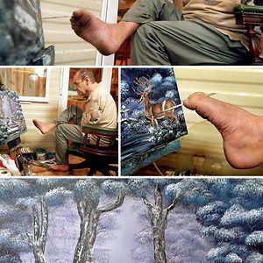
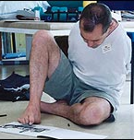
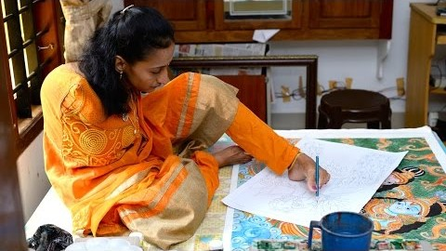
Incredible Foot Artists
Peter Longstaff is a ‘Foot Artist,’ who uses his feet as the medium of drawing. He was born without arms but has never considered himself disabled. He ran his own pig farm for twenty years after which he decided to pick up photography and painting and has risen to become a remarkable painter.
Swapna Augustine is an internationally acclaimed foot artist and honoured as ‘Icon of the year 2018’ by the World Malayali Foundation. Unlike ordinary people, Swapna was born armless but she fought her physical challenges and managed to achieve phenomenal achievements with her determination and courage.

Slide 7
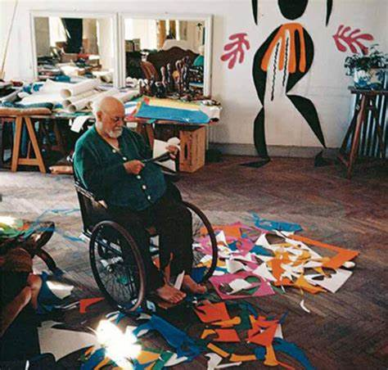
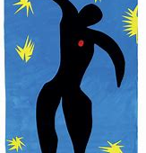
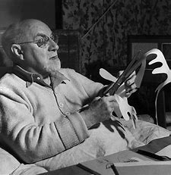
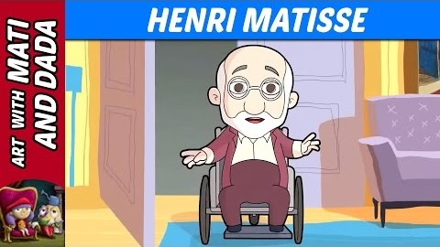
Henri Matisse 31 Dec 1869 - 03 Nov 1954 (age 84) Drawing with Scissors
Henri Matisse was born in northern France, in Le Cateau, on December 31, 1869. The son of a local grain merchant, Henri showed no early interest in art. Instead, after five years in a secondary school in St-Quentin, he went to Paris in 1887 to study law. In 1890, while he was recuperating from an attack of appendicitis, Matisse passed the time by trying his hand at painting with a set of oil paints that his mother had given him. “Henceforth,” he wrote, “I did not lead my life. It led me.”
In the last years of his life Matisse was confined to a wheelchair. As painting became increasingly difficult physically, the artist turned to his cut-out technique. He made shapes of paper with a scissor, which he then arranged using a long stick in a technique he called “painting with scissors.”

Slide 8

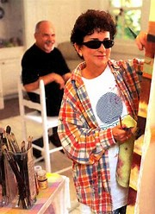

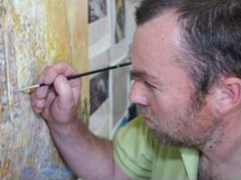
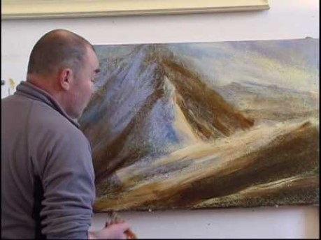
Lisa Fittipaldi & Keith Salmon (visually impaired artists)
Lisa Fittipaldi (born 1948) was a trauma-care nurse and a Certified Public Accountant before she lost her sight in 1993. Memories of having traveled the world with her husband Al, a career Naval Officer, has allowed her to depict daily life in astonishingly rich color and depth. Prior to her vision loss she had no art background. The challenge of a child’s watercolor set, thrown down like a gauntlet by her frustrated husband, opened the door to a new life in the field of art.
Keith Salmon (born 1959) is a British fine artist. His work is principally semi-abstract Scottish landscapes which are created based upon his experience as a hill walker. Even though he is registered blind Salmon has climbed more than one hundred of Scotland's Munros, many of which have been captured in his artworks.

Slide 9

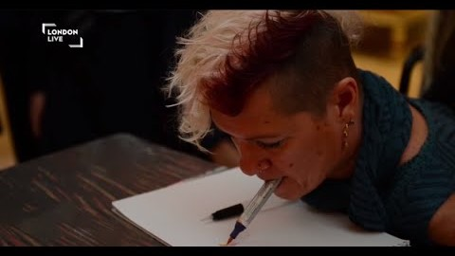
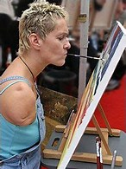
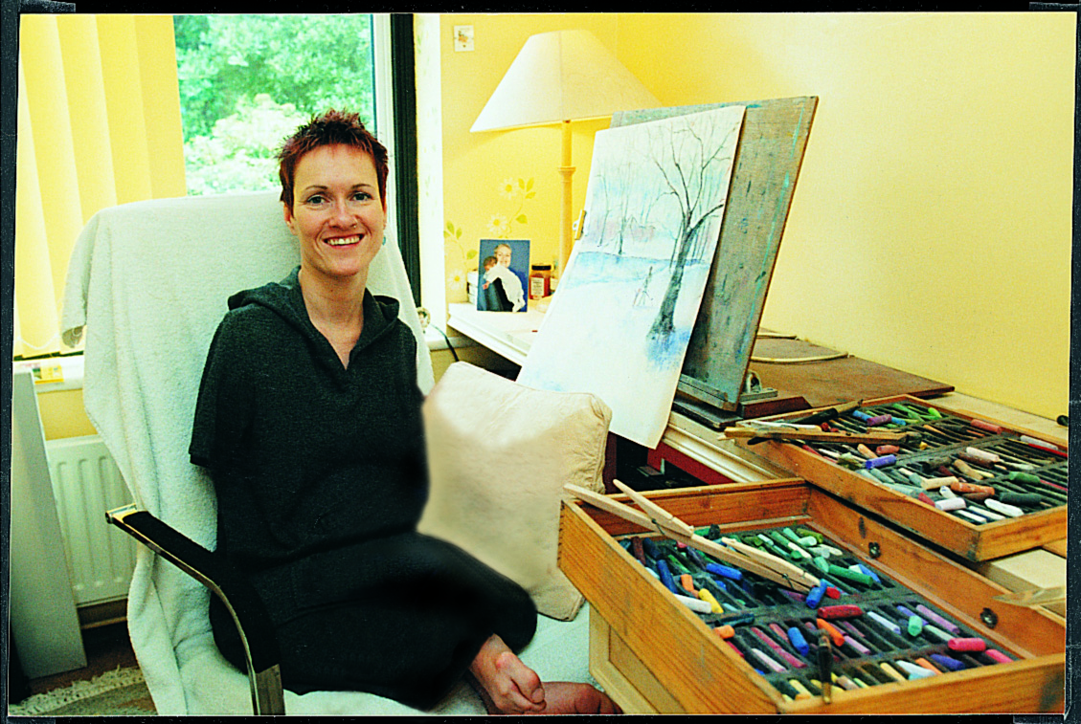
Alison Lapper (mouth artist)
Aged 19, Alison completed an Art foundation course at Heatherley School of Art, where she painted with her mouth.
At the age of 26, the Arts Faculty at The University of Brighton accepted Alison onto their degree course, their first ever disabled student. 3 years later she gained a First-Class Honors Degree in Fine Art.
When Alison was a teenager, she was invited to join the Mouth and Foot Painting Artists and she remains a full member today. As well as painting regularly for the MFPA Alison has had exhibitions of her own work in various countries including Korea, Switzerland and the UK.
In 2003, Alison received an MBE for services to Art and in 2014, she received an honorary doctorate from her alma mater.

Slide 10
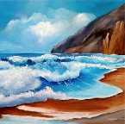
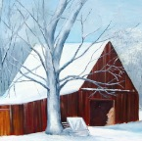
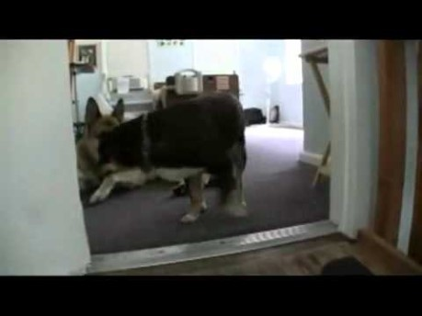
Michael Monaco (mouth artist)
Michael Monaco (born 1963) was injured in a car accident in 1979 at the age of 16. During extensive therapy at Kessler rehabilitation Hospital in East Orange, New Jersey, Michael had to learn to do many different tasks with his mouth such as sign checks, operate a wheelchair, and learn to operate an environmental control unit. The occupational therapists used to stick pencils in the patient's mouth and try to get them to sign their names to different documents. Once Michael mastered the pencil, he moved on to paint brushes and 25 years later he still painting with the brush in his mouth.

