Slide 1
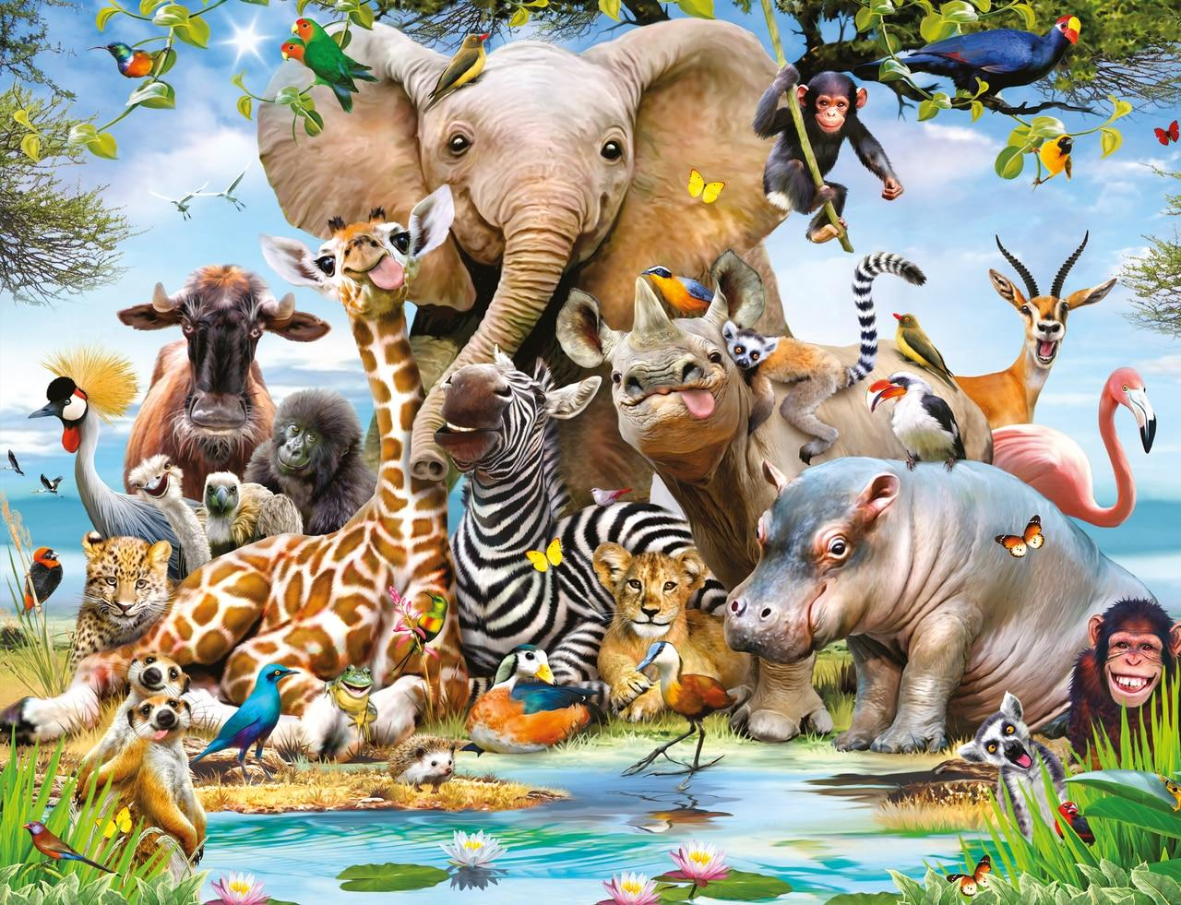

Year 3 Subject Safari: Emperors and Empires
Complete 2 tasks of your choice by half-term
Computing Choose an aspect of Roman life; Roman houses, Roman baths, Roman clothing or Roman religion. Create a fact file including: information and pictures. Make a stop motion animation of the story of Boudica or Romulus and Remus. | Art/DT/Cooking Find out what food the Romans ate and use these to design a menu for a Roman Café. Try to find the recipe for one of the dishes and have a go at making it! Create a Roman mosaic. | Science Grow a type of herb and keep a diary of its progress. The Romans loved to grow herbs for medicines.
English Write an acrostic poem for the word ROMANS. | Maths Using Roman numerals create ten different addition and subtraction word problems for the class to solve. | Games/P.E Create your own Tria roman board game by using old cereal box and have a go at playing it with someone at home.
R.E/P.S.H.E Research and discover each Roman deity and what he/she was responsible for. | Music Research three musical instruments that the Romans played. Draw a picture and write one piece of information about each instrument. Which instruments would sound similar today? | History/Geography Map out where Romans built roads in the UK.

